Slide 1

Lecture 3
Reconnaissance
Ethical Hacking
Diploma in CSF
Year 3 (2020/21), Semester 5
Notes:
Left-hand Bar – Replace FSP by your module code and X by the lecture number.
Replace Lecture Title
Replace < Module Name >
Replace Year and Semester if necessary

Slide 2
Learning Outcomes
At the end of this lecture, the students will be equipped with knowledge and various skills to gather intelligence about the targets from publicly available sources.

Slide 3
Learning Objectives
At the end of this lecture, students will be able to:
Explain the concept of Reconnaissance in Pen-Test;
Discuss each of the activities involved in Reconnaissance phase;
Make use of the tools introduced in this lecture to gather information of the target organizations or users; &
Name other tools that can be used for reconnaissance purpose.

Slide 4
Contents
What is Reconnaissance ?
Reconnoiter Intelligence for Network and Systems Pen-Test Project
Information about Target Organization
Tools for Reconnaissance
Intelligence Gathering through Network Resources
Intelligence Gathering through Internet/WWW
Intelligence Gathering through Automated Tools
Keeping an Inventory of Entities Discovered
Other Reconnaissance Tools

Slide 5
What is Reconnaissance?

Slide 6
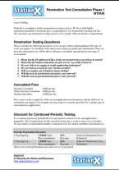
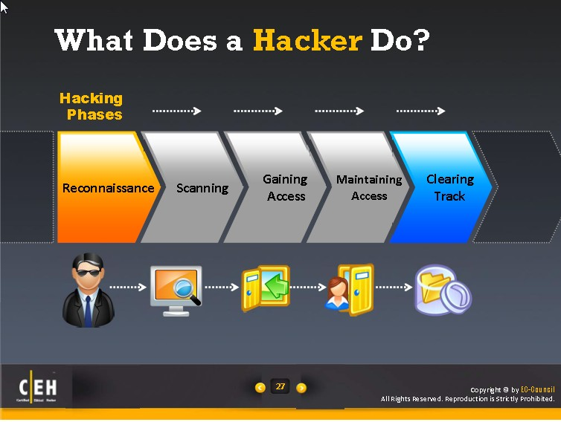
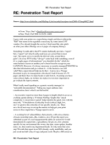
Our Pen-Test Process Model
Planning
Reconnaissance
Scanning
Exploit Systems
Reporting

Slide 7
Reconnaissance Concept
It involves activities to research and gather information to learn more about the target organization. In particularly the security posture of the organization.
Technically, Reconnaissance refers to the art of reconnoitering, which is a fancy way of saying to go and check things out. The word is often used in military to refer to obtaining military information about a place by sending soldiers or planes there, or by the use of satellites.
In EH context, it is about to go online to gather information needed for a network and systems pen-test project. These information are often can be found in the pubic domain and it is referred to as Open Source Intelligence (OSINT). The word Intelligence implies that these mined public contents when put together, they become useful information as intelligence.

Slide 8
Reconnaissance is the second phase in our Pen-Test Model. This is the phase where most information needed to prepare for the pen-test project are gathered.
It is to note that there are also be information gathering activities prior to contract singing, planning phase and all other phases where necessary.
The information/intelligence gathered must also be meaningful and purposeful for any particular pen-test project.

Slide 9
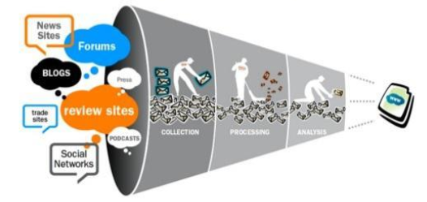
There are tons of public domain information available for mining, Pen-testers need to know what to mine, where to mine, how to mine and use what to mine given the time and man-power.
The depth of information also translate to time and efforts needed, hence it cannot be under estimated.

Slide 10
Information about Target Organization
Depending on the job/contract at hand, gather the relevant organizational information related to the job/contract.
There are no fix rules and involve some thinking…
Major Businesses
Main Products and/or Services
Board Directors, Management Staff and Officers
Physical Office locations - Main and Branches (if any)
Partners and/or Collaborators
Network and System Infrastructure
…

Slide 11
Sources of Information
Web-sites (Corporate Website, eCommerce Portal, Product Support Website…)
Social Networking Site (e.g. Facebook )
Corporate Annual Report (For all public listing company or semi government companies)
Press Releases (e.g. company website, newspaper, news website)
People Searches
Company Directory
http://people.yahoo.com
Google Phonebook
http://pipl.com
Company documents (e.g. penetration report, system related documents, design & configuration documents…) – Soft Copy and Hard Copy
Any staff left
Open Job Requisitions
Job requirements give away information on network infrastructure, types of equipment, software system, etc.
…

Slide 12
Reconnoiter Intelligence for Network and Systems Pen-Test Project

Slide 13
In Web Application Penetrating Testing (WAPT) module, we mainly look for information on server that host the web application, the web architecture, and the technology deployed.
In Network and System Penetration Testing Project, we concentrate on looking for IP addresses that is used by the target organization. IP address leads to network addresses and host devices, and many other information needed for executing the pen-test project.

Slide 14
Depending on the nature of the projects, these other information such as domain names, staff directory, past pen-test report could also be useful resources.
There are no fix rules on what to mine first and the depth to mine, usually there is an instinct in one to know what come first and so on. However, the depth of information required might need to be determined.

Slide 15
Tools for Reconnaissance

Slide 16
Tools for Reconnaissance
There are wide variety of tools to choose from and most of these are included under the OSINT Framework put together by Justin Nordine.

Slide 17
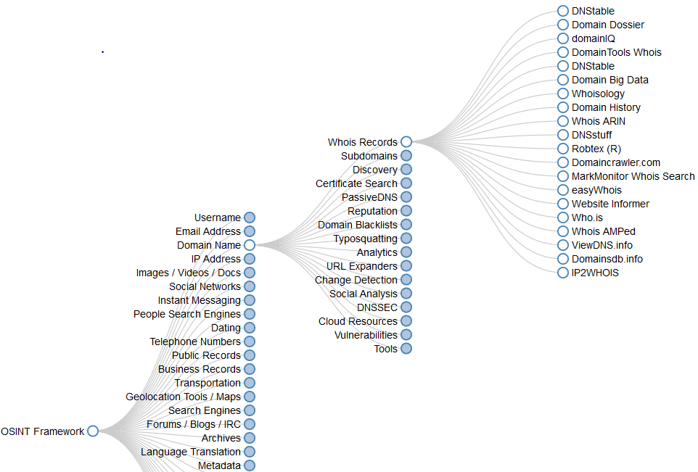
In the framework, the tools are being categorized and sub-categorized in accordance to their different purposes and nature.
https://osintframework.com
Try the tool at the above link.

Slide 18
Activity 3.1 - Thinking
Imagine you are working on a pen-test project involves networks in two buildings as shown in the diagram on next slide.
Suggest and explain as many methods as possible to find out the network ID for each of the subnets.
Type your answers in the spreadsheet prepared by your module leader in Week 3 Channel in Team.
Complete this before week 5

Slide 19
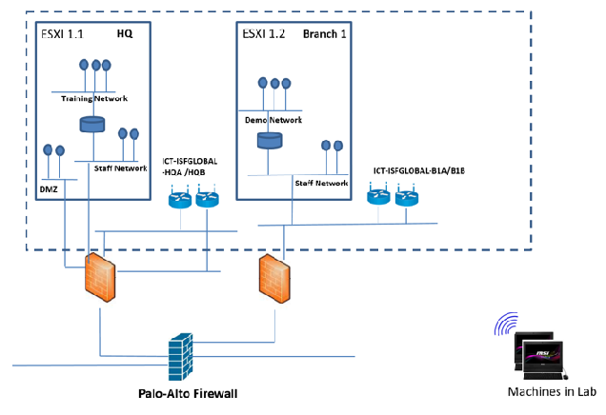

Slide 20
Intelligence Gathering through Network Resource

Slide 21
The following slides present tools for gathering intelligence from the open network resources in the public space.

Slide 22
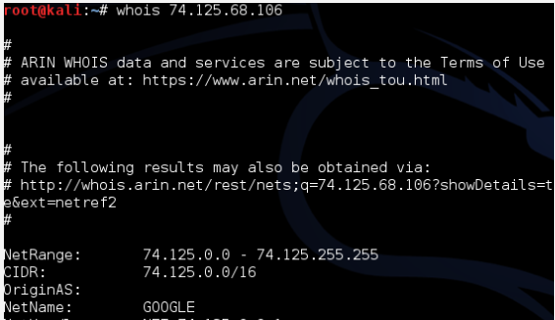
[1] whois - For our purpose, use whois to retrieve range of public IP of the target organization subscribed to.

Slide 23
Whois Searches
(EXTRA)

Slide 24
Whois Searches
Organization registered themselves as an Internet Domain
e.g. www.np.edu.sg , www.yahoo.com …
Registration information is stored in Whois database distributed around the world.
Start search from InterNIC and SIGNIC(for domain name ends with .sg)
Other sites that provide whois service:
http://www.whois.com
http://www.whois.net
http://www.geektools.com
http://www.networksolutions.com/whois/index.jsp
http://www.dnsstuff.com/

Slide 25
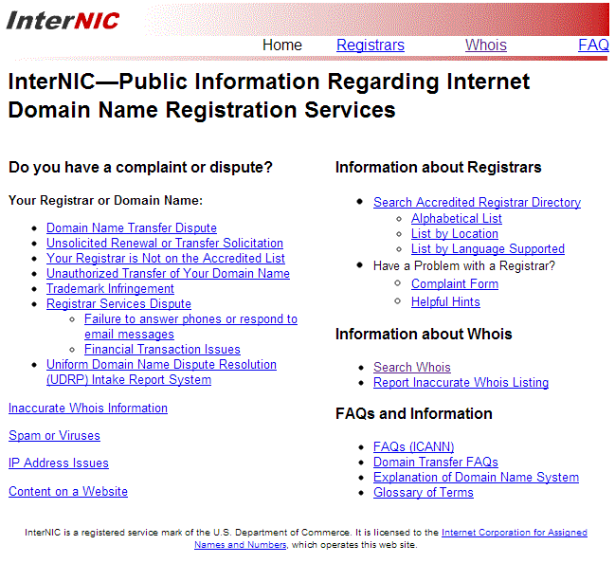
http://www.internic.org/

Slide 26
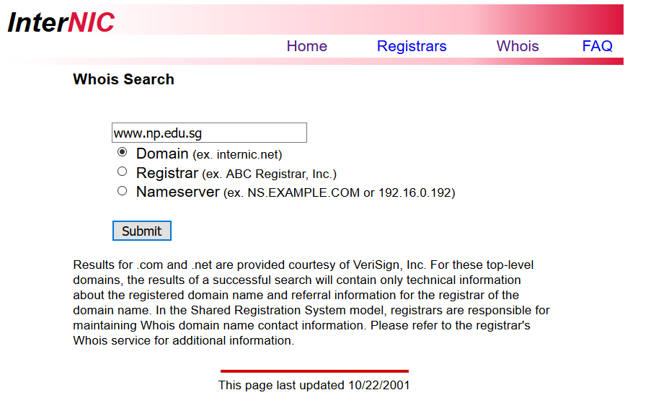

Slide 27
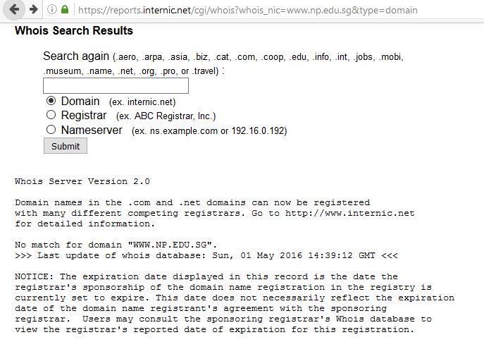
Because it is not registered here.

Slide 28
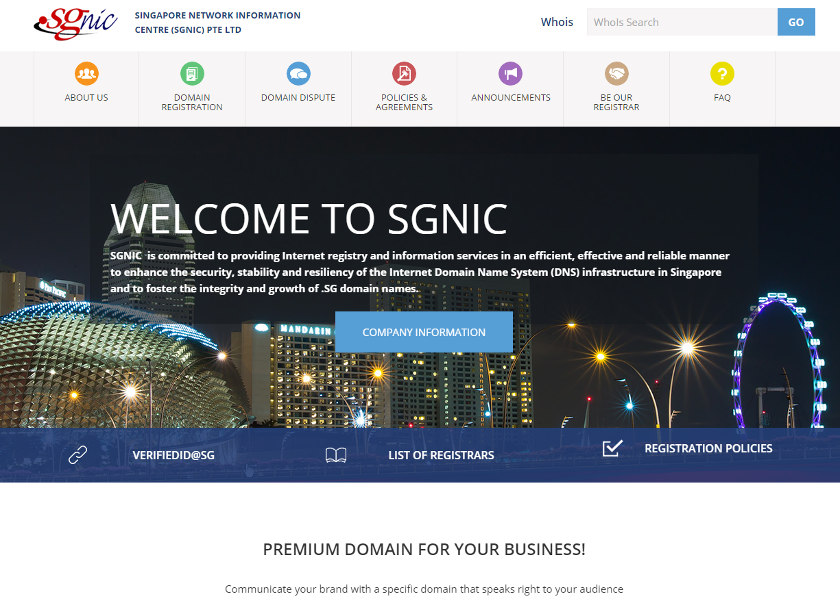
http://www.sgnic.sg/

Slide 29
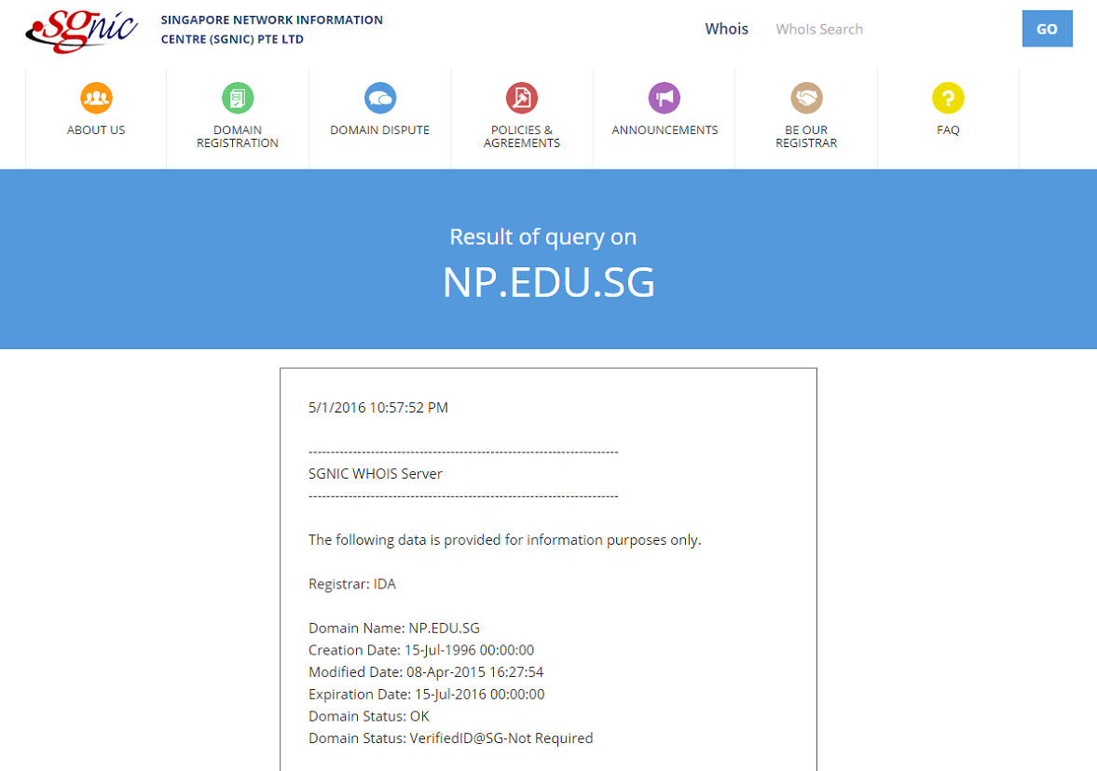

Slide 30
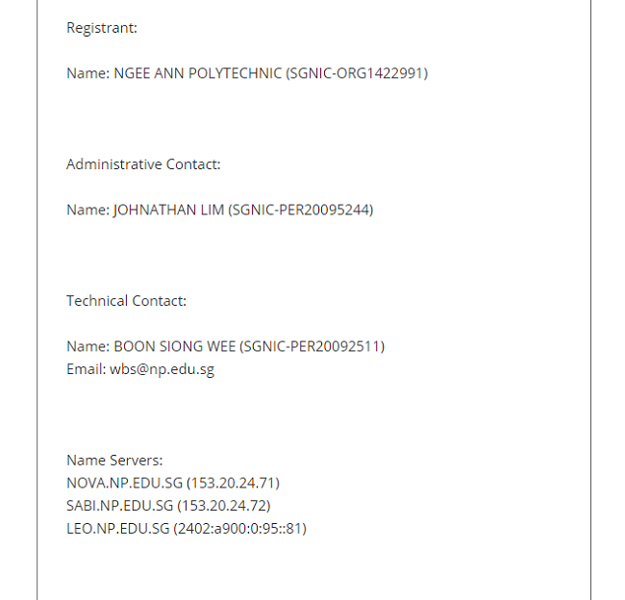

Slide 31

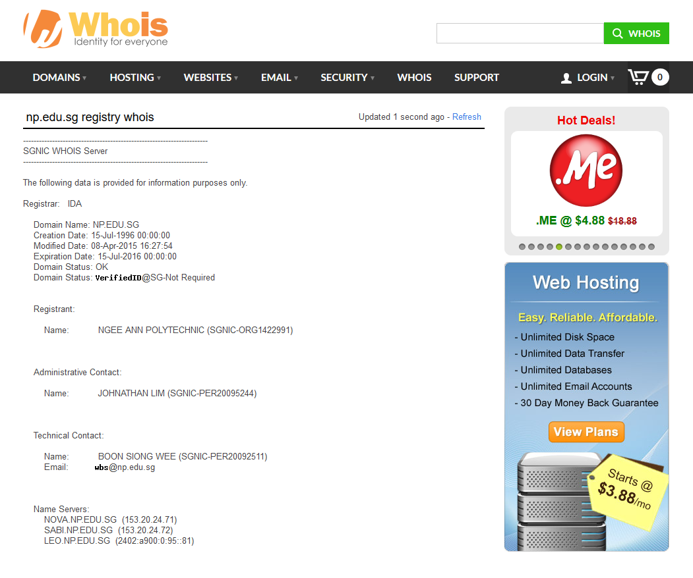
This is NOT NIC authority, it is a commercial company. Their “whois” searches all relevant databases.

Slide 32
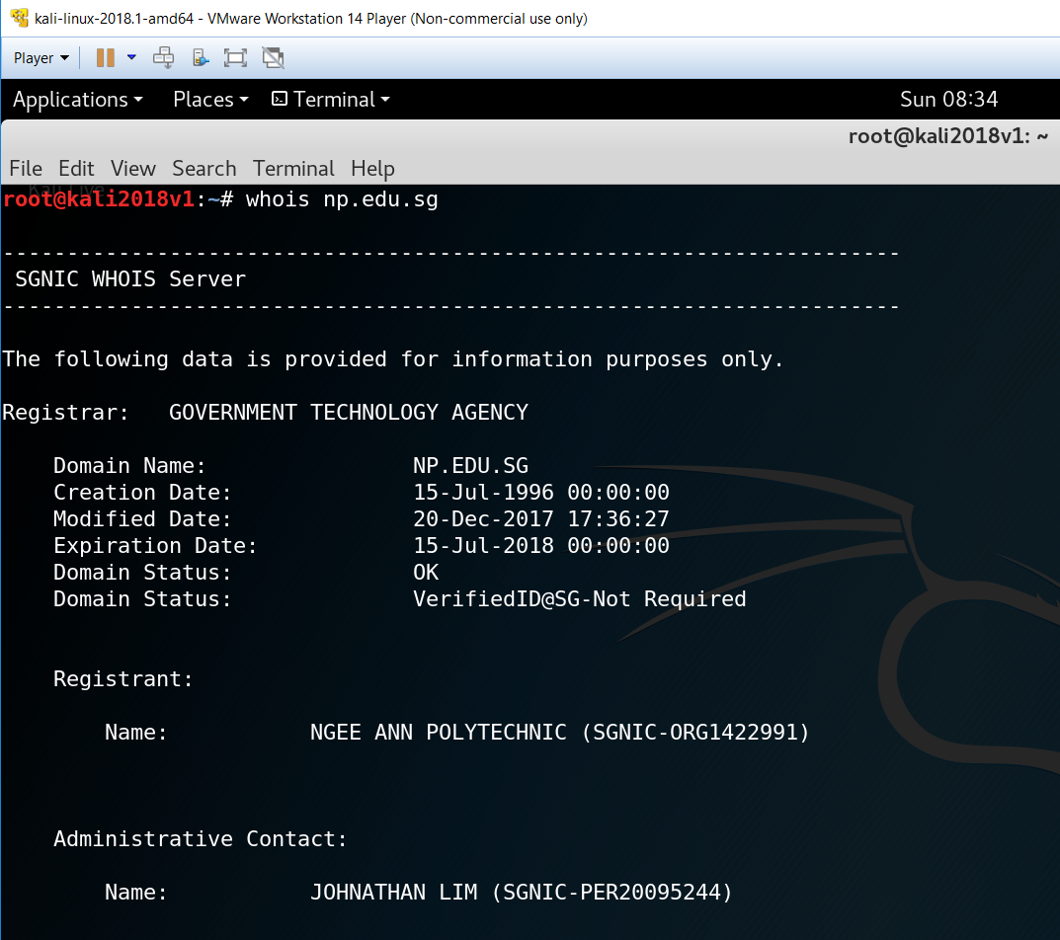
Use “whois” command in Kali-Linux

Slide 33
Internet IP Addresses used by Organization
(EXTRA)

Slide 34
IP Address Block Assignment
Each organization is assigned with an IP Address Block
These IP Address Block obtainable from Regional Internet Registries (RIRs)’s Whois databases.
ARIN(American Registry for Internet Numbers)
US, Canada, Certain Caribbean Island
RIPE NSS (Research IP Europeans Network Coordination Centre)
Europe, Middle East, part of Central Asia
APNIC (Asia-Pacific Network Information Centre)
Asia-Pacific region
LACNIC (Latin American and Caribbean Internet Address Registry)
Latin American, most part of Caribbean
AfriNIC (Africa Network Information Centre)
African Continent

Slide 35
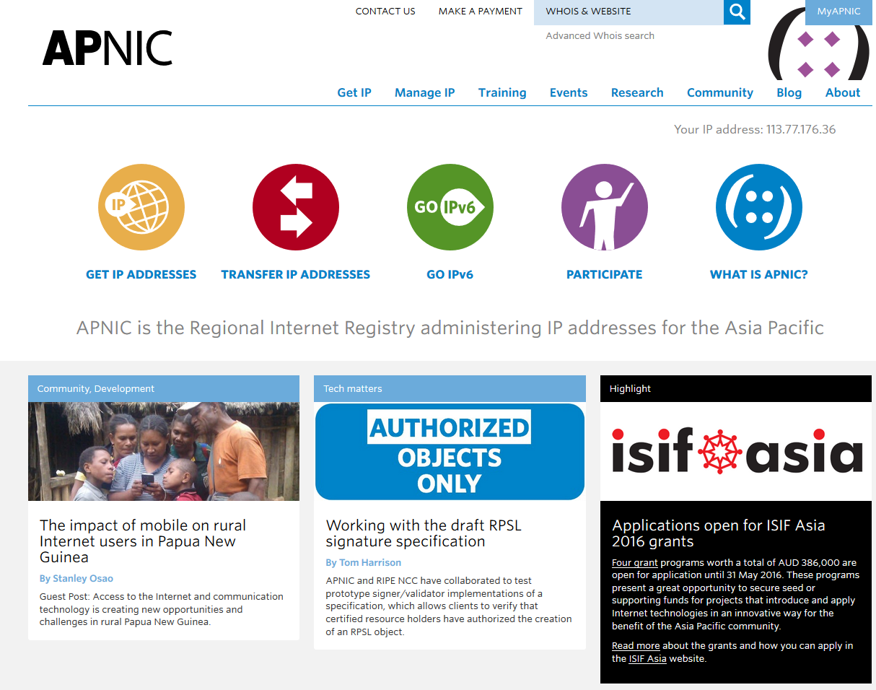
https://www.apnic.net
Turn your URL to APNIC and hunt down the range IP addresses assigned to NP. (hint: enter IP address of the web server for whois)
Enter 153.20.24.192

Slide 36
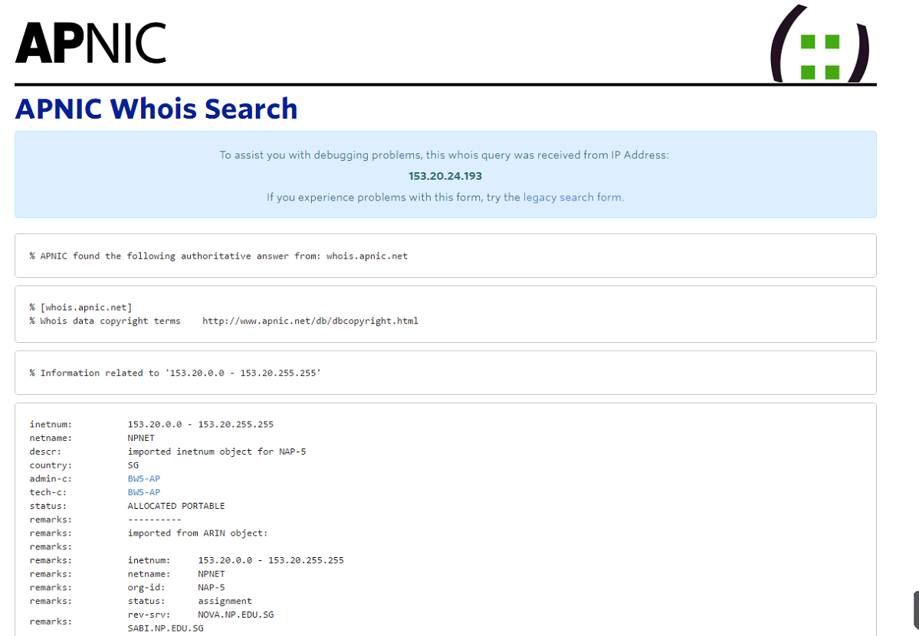
Class B

Slide 37
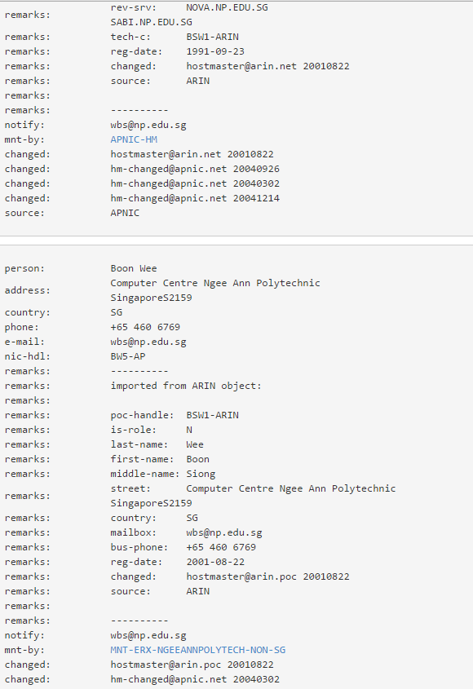

Slide 38
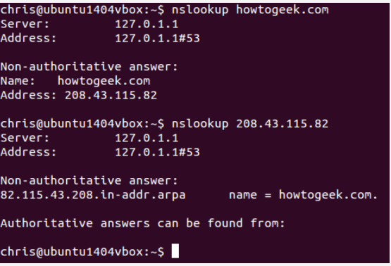
[2] nslookup - Perform a reverse lookup to find the domain name associated with an IP address

Slide 39
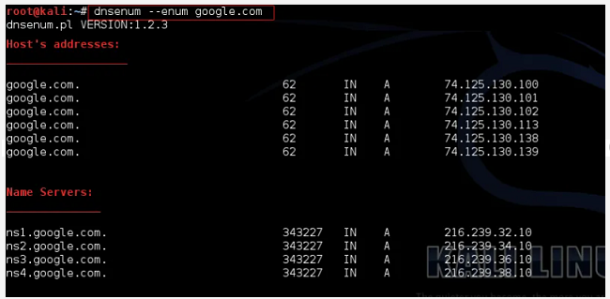
[3] dnsenum - Locating all DNS servers and DNS entries for an organization.

Slide 40
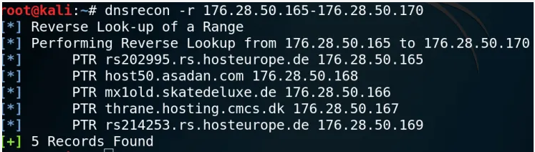
[4] dnsrecon - Can be used to perform reverse lookup for name servers in a range of IP address.

Slide 41
DNS Interrogation
(EXTRA)

Slide 42
DNS Interrogation
Pen-Testers could harvest useful records by interrogating the known name servers.
Goal is to discover as many IP addresses associated with the target domain.
Interrogation process needs knowledge of Linux commands and depends on setting of DNS servers.

Slide 43
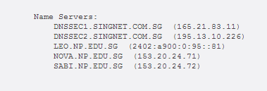
Domain Name Servers(DNS)
Also referred to as name servers.
They focused on resolving names into IP Addresses and vice versa.
Like Whois searches, DNS Lookup returned a list of name servers, in the order or primary, secondary and tertiary (If any) name servers.

Slide 44
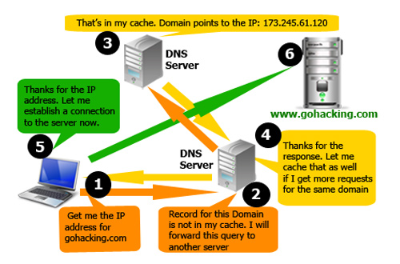
How Domain Name Servers work?
http://crack001.com/computer/how-domain-name-system-work-dns/

Slide 45
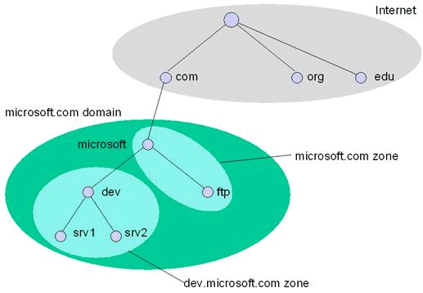
Domains vs. Zones

Slide 46
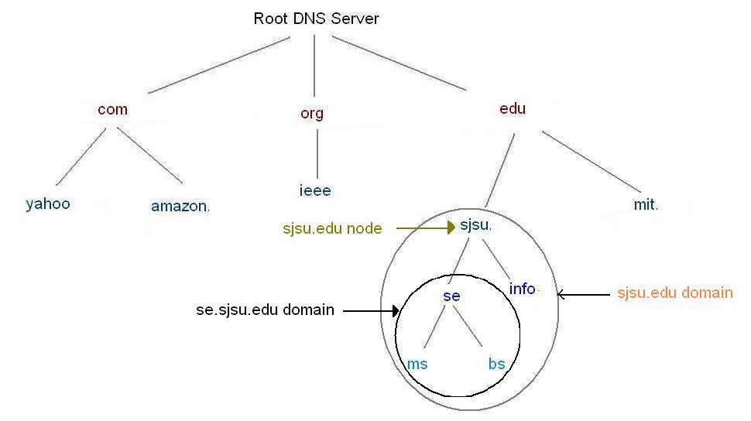

Slide 47
“Zone transfer” is the name for the process used to keep multiple DNS servers hosting information about the same domain synchronized with the same set of data.
A single server is designated as the “primary” server and all others are “secondary” servers. Information is updated on the primary server only, so a mechanism exists to propagate that information to each of the secondary servers. This mechanism is the “zone transfer”.
Most of the network administrators disallow zone transfers from anyone but a secondary DNS server, but sometimes we’ll find an improperly configured DNS server.

Slide 48
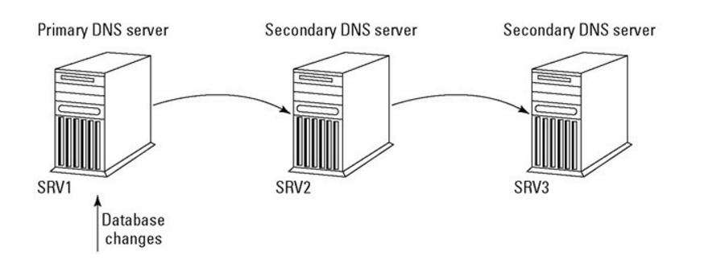
Source: http://what-when-how.com/tcpip/serving-up-dns-the-domain-name-system-tcpip-part-2/

Slide 49
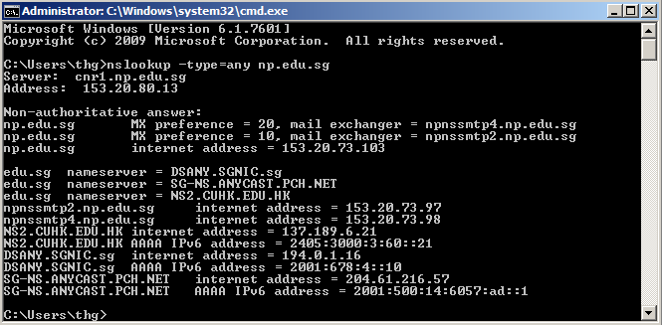
In windows OS
>nslookup –type=any np.edu.sg

Slide 50
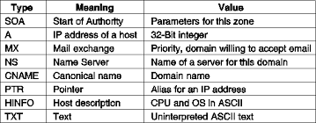
Source: https://mariocube.com/resource-record.html

Slide 51
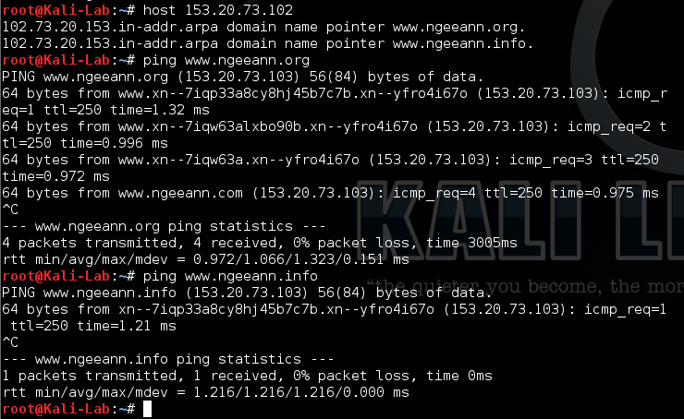
In Kali Linux
#host 153.20.72.103
New servers found !!
This is NOT NIC authority, it is a commercial company. Their “whois” searches all relevant databases.

Slide 52
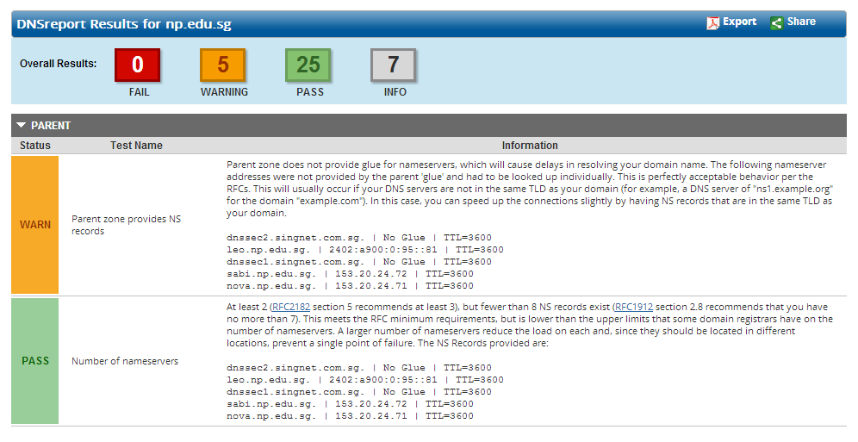
http://www.dnsstuff.com/

Slide 53
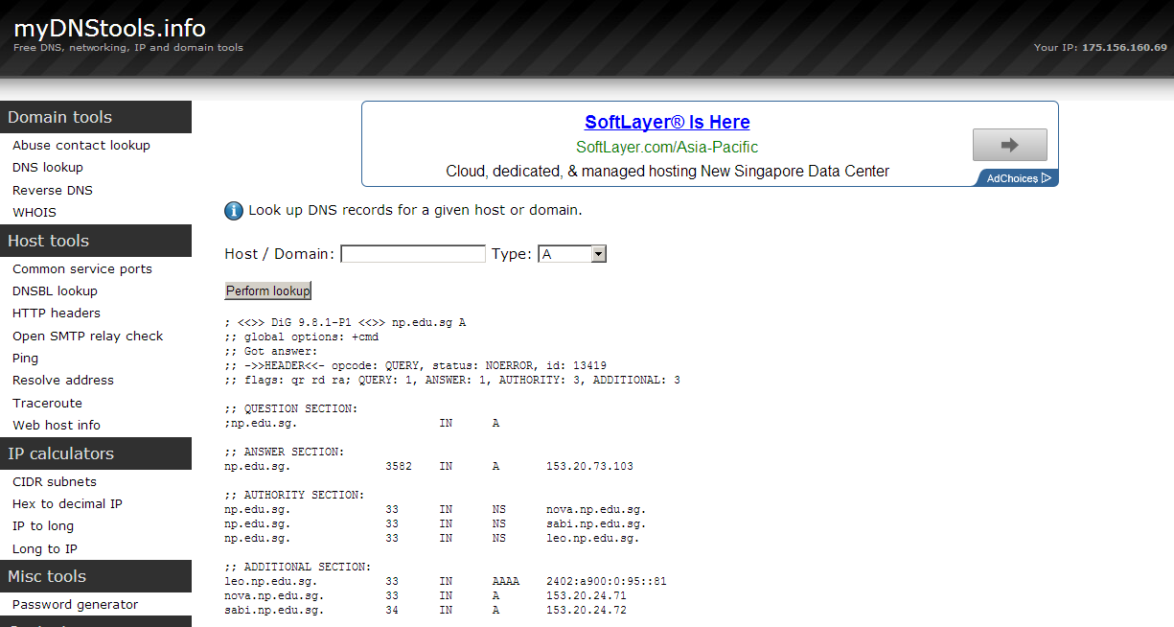
http://www.myDNStools.info

Slide 54
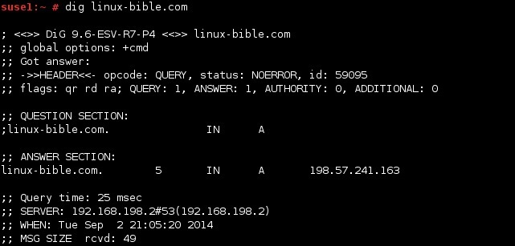
Use of “dig” command in Kali Linux

Slide 55
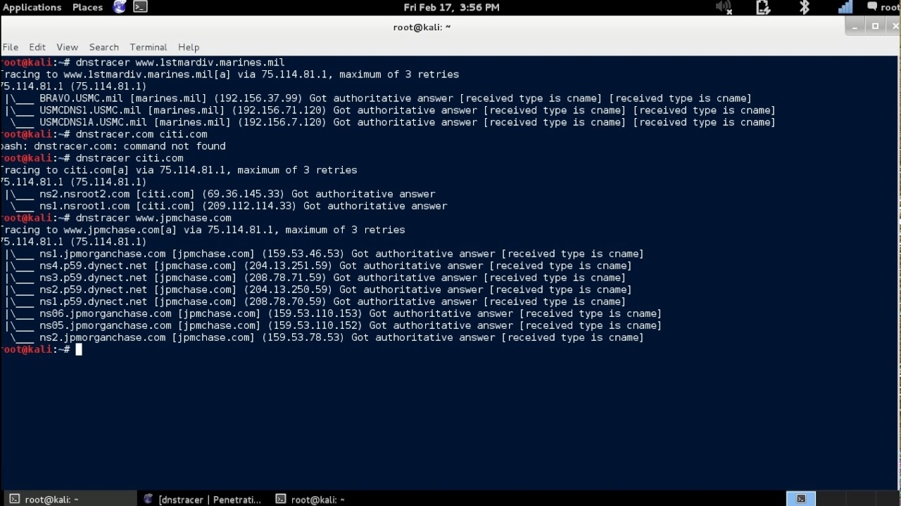
Use of “dnstracer” command in Kali Linux

Slide 56
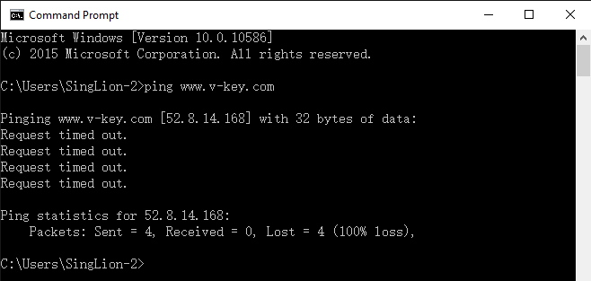
Network and System Pen-Tester interested and go after IP Addresses.
The Domain Name and Name of Name Servers(DNS Server) are no use to them.
The Names can be resolved by DNS server located anywhere on the network.
The simplest way is to ping the name identified.

Slide 57
Intelligence Gathering through Internet/WWW

Slide 58
In this section, we look at OSINT tools that allows us to gather intelligence through the World-Wide-Web or the Internet.
As mentioned previously, Pen-testers for Network and Systems pen-test project are interested in finding the IP addresses of the Target organization using and having.
To find out what IP addresses the organization is using, we can make use of the tools in the next few slides.

Slide 59
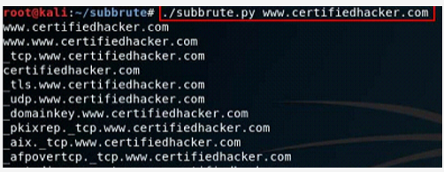
[1] subbrute - to find out the Internet domain and sub-domain names that the organization uses.

Slide 60
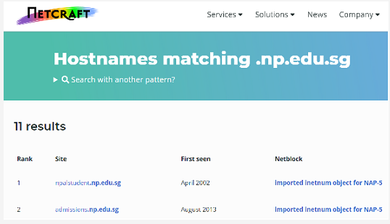
[2] netcraft - usage same as [1], but is web-based.

Slide 61
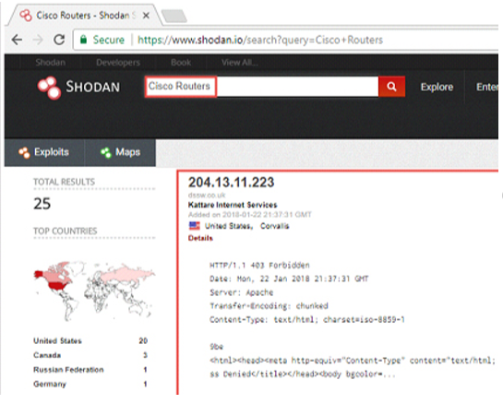
[3] Shodan - find devices that the target organization uses

Slide 62
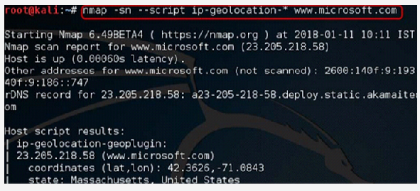
[4] NSE - nmap scripting engineering to find geographical location of the target device.

Slide 63
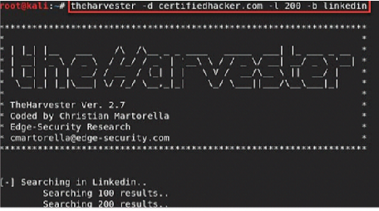
[5] thehaverster - to harvest email addresses to use for social engineering.

Slide 64
Intelligence Gathering through Automated Tools

Slide 65
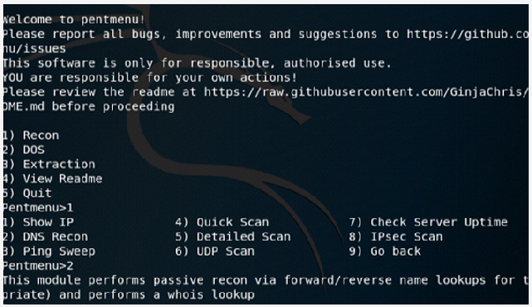
Automated Tools
[1] penmenu - bash script with functions for automated pen-testing, include information reconnaissance.

Slide 66
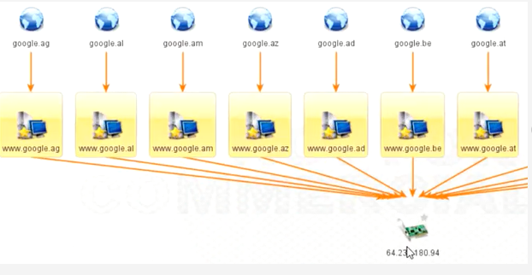
[2] maltego - More than a people search tool, it can also search and relate devices. Powerful automated tool for reconnaissance.

Slide 67
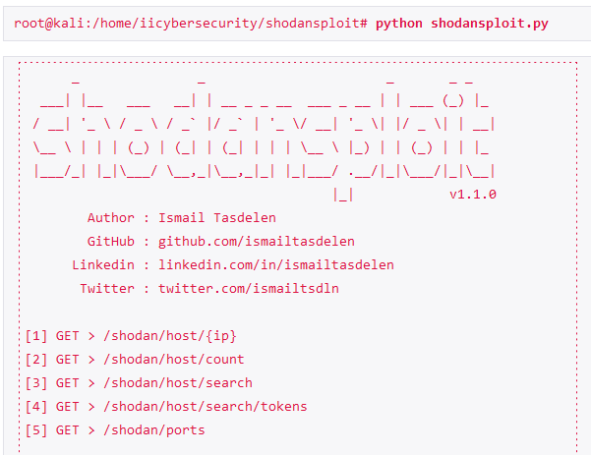
https://www.securitynewspaper.com/2019/02/17/shodan-gets-more-simpler-using-shodansploit/
Shodansploit is a tool that make use of Shodan commands to make details search on target. This tool also provide specific searches that possible.
Shodansploit works with shodan API and works according to API privilege you have.
git clone https://github.com/ismailtasdelen/shodansploit.git

Slide 68
Activity 3.2 - Exploration
Test out shodanploit in Kali Linux 2021.1 in your notebook.
Record and submit the steps taken in the a powerpoint file in Week 3 Channel in Team.
Name the file as Act3.2-Full Name
Complete this before week 5.

Slide 69
Keeping an Inventory of Entities Discovered

Slide 70
Keeping an Inventory of Entities
To establish a good records of all item discovered and information gathered during reconnaissance phase is a MUST DO task for Pen-Testers.
Information may not be complete but can be further obtained in a later phase.
It is the responsibility of EVERY member in the Pen-Test team to update the records.
Keep details on “How Discovered” so that the tasks can be reproduced.

Slide 71
Basic Inventory Template
Target IP Addr | Target Name | Target OS | How Discovered | Listening Ports | Known Vulns | Admin Accts / Passwds | Other Accts / Passwds | Misc Notes

Slide 72
Discovered Methods
Enter these and details:
Revealed by organization personnel
Discovered by Search engines
Discovered by DNS lookups
Discovered by physical assessment or wireless assessment
Discovered by network sweep
…

Slide 73
Inventory Tools
MediaWiki, Open Source
http://www.mediawiki.org/wiki/MediaWiki
Dradis, Open Source
http://dradisframework.org/

Slide 74
Other Reconnaissance Tools

Slide 75
Tools and Tools and Tools…
There are many tools for reconnaissance purpose. They came in different strengths and weaknesses.
We are interested in tools that focus in system and network testing purpose.
Sometime tools for web penetration testing can also be of good use, depending on your purpose and objective.

Slide 76
Summary

Slide 77
Summary
What is Reconnaissance ?
Reconnoiter Intelligence for Network and Systems Pen-Test Project
Information about Target Organization
Tools for Reconnaissance
Intelligence Gathering through Network Resources
Intelligence Gathering through Internet/WWW
Intelligence Gathering through Automated Tools
Keeping an Inventory of Entities Discovered
Other Reconnaissance Tools

Slide 78
Q&A

Slide 79
End

